Slide 1

DESIGN OF UNDERGROUND RCC WATER TANK USING EXCEL
UNDER THE GUIDANCE OF DR. PK JAIN SIR
Presented By :
Divyansh Shivhare (211111019)
Anushka Thakur (211111027)
Riya Katiyar (211111048)
Divyansh Tiwari (211111228)
MANIT, BHOPAL

Slide 2
INTRODUCTION
1
Underground RCC water tanks play a crucial role in storing water efficiently, particularly in urban and rural areas facing space constraints and water scarcity . Their construction includes many factors such as the condition of soil, water table levels, and structural requirements to ensure structural stability and integrity.

Slide 3
OBJECTIVES
1
1. To develop excel program for the design of underground water tank to avoid the tedious calculations.
2. To ensure the structural integrity and stability of the tank under various loads.
3. To provide detailed construction drawings and guidelines for building the water tank.

Slide 4
FORCES ACTING ON UNDERGROUND WATER TANK
2
Soil Pressure: Soil exerts lateral pressure on tank walls, influenced by factors like soil type and groundwater level.
Dead Loads: The weight of the tank itself, along with permanent fixtures like reinforcement bars and covers, must be considered.
Live Loads: Transient loads during operation or maintenance need to be accounted for in design.
Temperature and Thermal Expansion: Thermal stresses from temperature variations must be managed to prevent damage.
Hydrostatic Pressure: Water weight in the tank creates pressure on walls and base, increasing with depth.

Slide 5
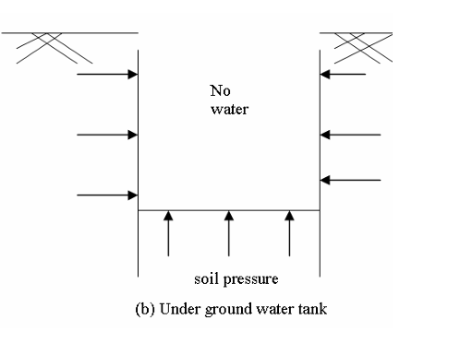
3
WORST CASE SCENARIO
Tank Empty , fully saturated soil condition
In this case, when there is no water available in the tank, the force applied by the tank is only the self weight of the tank. And the opposing forces are that of uplift due to the water present in the soil.
Thus, in this case the self weight of tank should be designed in such a way that it is capable of balancing the uplift due to water present in the soil.

Slide 6
4
COMPONENTS OF WATER TANKS
LONG WALLS
SHORT WALLS
Provides the primary structural support and containment for the water tank.
Offers additional structural support, typically perpendicular to long walls, contributing to the overall stability of the tank.
BASE SLAB
ROOF SLAB
Distributes the weight of the water evenly to the foundation, preventing uneven settlement and ensuring structural integrity
Protects the water from external contaminants and elements, ensuring water quality and minimizing evaporation.

Slide 7
5
DESIGN METHODOLOGY
For the design of underground RCC tank through our project, we have utilized the working stress method. The reason for choosing the working stress method is majorly the ease of calculations and thus, easier integration with MS Excel, making it a better choice for our project.
The working stress method tends to be more conservative, thus providing an additional margin of safety to ensure structural stability.

Slide 8
6
The first step involves the calculation of Design constants.
Now, on the basis of L/B ratio, we determine how the long walls, short walls and slabs are to be designed. For L/B ratio greater than 2, the walls are designed as cantilever. The roof and base slabs are designed as 2-way slabs.
Then, we proceed with calculating the bending moments at the various points.
With the use of bending moments calculated, the reinforcement details are calculated.

Slide 9
7
DEMONSTRATION OF THE PROJECT

Slide 10
8
CONCLUSION
Through this project, we have tried to develop an excel program for designing the various components of underground RCC water tanks. Also, we seek to emphasize on the data provided in Design of RCC structures by Dr. B.C. Punmia and solved various equations to obtain specifications such as the reinforcements required and concluded the results using various figures. This program provides applications useful to real life applications with slightly changed (increased) values, so designers should not, in any case, provide values less than the program's values to ensure safety.

Slide 11
FUTURE SCOPE
9
As a part of expansion of this project, we may include the design for overhead water tanks too. A comprehensive consideration of other forces like gravity load, axial load, shear forces, etc. is to be made for this expansion, to ensure the structural stability and integrity.
Moreover, cost estimation methodologies and comparison between the costs of construction for underground and overhead water tanks may be integrated.
Additionally, the impact of depth of water table on the structural stability of water tank may also be included.
Expansion of the project will help the program provide the users with more valuable insights for the actual execution of the project.

Slide 12
REFERENCES
10
RCC Designs by Dr. B.C. Punmia
To develop the excel program, we have gathered all the important information and design methodologies from the book “RCC Design by Dr. B.C. Punmia”.
IS: 3370 - 2009 for design considerations of underground RCC water tank.
IS: 456 - 2000 for the stresses in concrete.
IS codes have been utilized in order to design strictly according to the Indian Standards for Design of water retaining structures.

Slide 13
THANK YOU

